Slide 1
Windows System Administration
Telerik Software Academy
academy.telerik.com
Monitoring Server Performance
Organizing Your Support Model
Borislav Varadinov
System Administrator
bobi@itp.bg

Slide 2

Table of Contents
Monitoring Tools
Monitoring Good Practices
Organize Your Support Model

Slide 3
Monitoring Tools and Good Practices

Slide 4
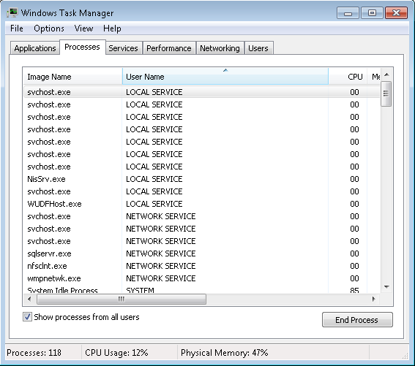
Task Manager

Slide 5
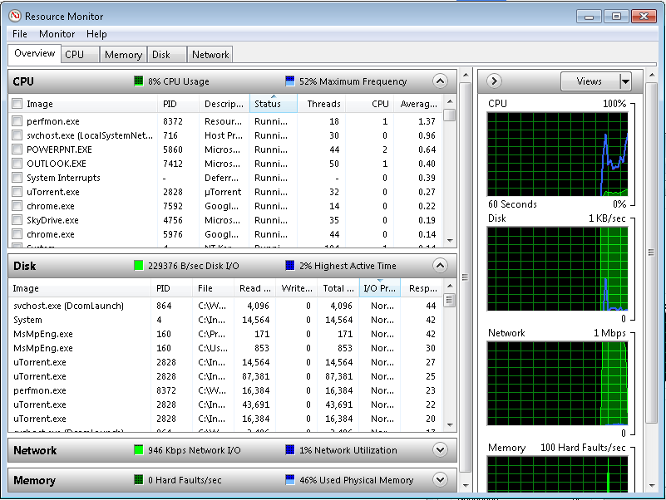
Resource Monitor

Slide 6
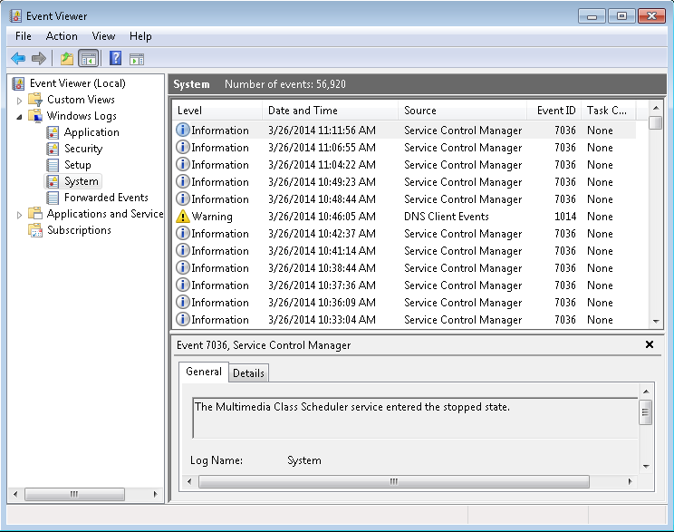
Event Viewer
Event Viewer is a tool that provides access to the Windows Event Log system

Slide 7
Event Log System
Application
System
Security
Operational Event Channels

Slide 8
Event Types
Level Types
Information
Error
Warning
Additional types in Security Log
Audit Failure
Audit Success

Slide 9
Event Log Tricks
Filters
Custom Views
Tasks
Subscriptions

Slide 10
Performance Monitoring
Real Time
Performance monitoring
Service level agreements
Event logs
Retained performance logs
Historical
Task Manager
Event Viewer
Network Monitor
Performance Monitor
Resource Monitor
System Center Operations Manager
Tools
Notes:
10967A
12: Monitoring Server Performance

Slide 11
Data Collector Set
Building block of performance monitoring and reporting in Windows Performance Monitor
Organizes multiple data collection points into a single component
Data Collector Sets can contain the following types of data collectors:
Performance counters
Event trace data
System configuration information (registry key values)

Slide 12
Sysinternals
Process Explorer
Process Monitor
PsExec
Autoruns
TCPView
http://live.sysinternals.com/

Slide 13
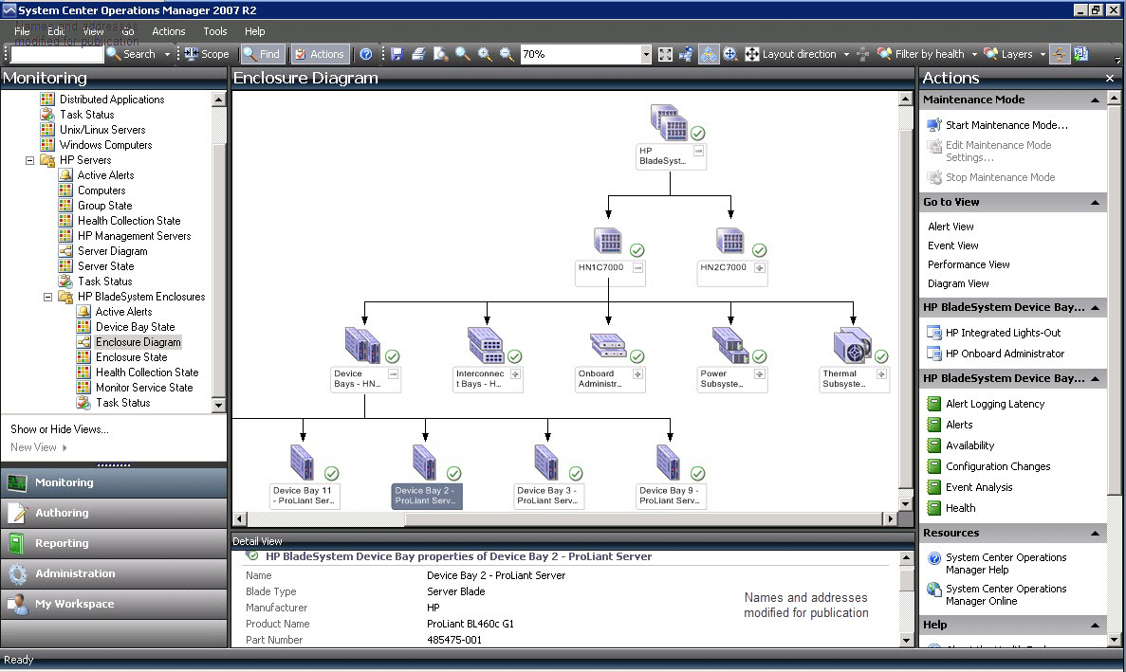
System Center Operations Manager (SCOM)

Slide 14
Monitoring and Troubleshooting Good Practices
Use proactive monitoring solutions
Make one change at a time
Repeat monitoring after every change
Routinely review event logs and performance data
Collect logs in central repository
For distributes system, try to isolate each component
Create capacity planning and baseline

Slide 15
Organize Your Support Model

Slide 16
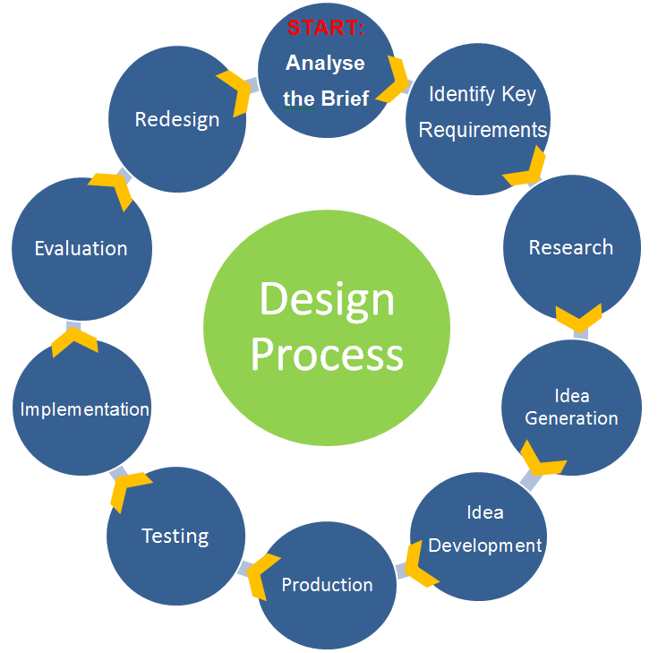
Business Process
A business process is a collection of related, structured activities or tasks that produce a specific service or product

Slide 17
Processes Characteristics
Transform inputs into outputs
Deliver results
Measurable
Triggered by specific events

Slide 18
ITIL
ITIL addresses a number of specific processes
The most widely accepted approach to IT service management in the world
Provides a set of best practice
Provides a practical framework for
Identifying
Planning
Delivering
Supporting

Slide 19
Adopting ITIL can offer benefits
Improve IT services
Reduce costs
Improve customer satisfaction
Improve productivity
Improve use of skills and experience
Improve delivery of third party service
http://www.itil-officialsite.com/AboutITIL/WhatisITIL.aspx

Slide 20
Common IT Service Management Processes
Configuration Management
Change Management
Incident Management
Problem Management

Slide 21
Configuration Management
Tracks the configuration of any components that support IT services:
Functional and physical attributes
Operational information
Relationships and Dependencies
Configuration Management Database (CMDB)
Configuration Item (CI)

Slide 22
Change Management
Planning
Recording
Evaluating
Approving
Testing
Reviewing
Any changes in the environment

Slide 23
Incident Management
Incident Identification
Registration
Categorization
Prioritization
Escalation
Investigation and diagnosis
Resolution and recovery
Incident closure

Slide 24
Incidents and Problems
Incident
An incident is any occurrence which causes or may cause interruption or degradation to an IT Service
Problem
A problem is the unknown underlying cause of one or more incidents. A problem is NOT just a particularly serious incident

Slide 25
Errors and Know Errors
Error
An error is the known underlying cause of one or more incidents
Known Error
A known error is the known cause of an incident for which a workaround also exists.

Slide 26
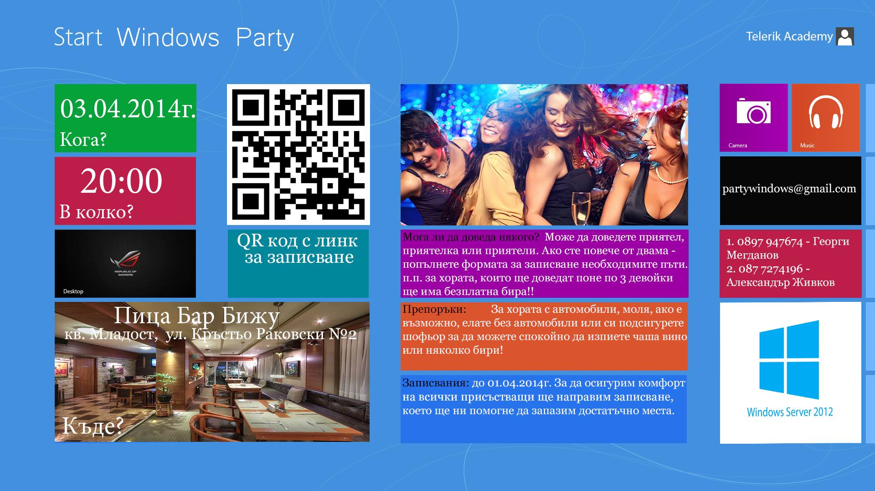

Slide 27
Monitoring Server Performance
http://academy.telerik.com

Slide 28
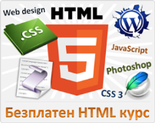



Free Trainings @ Telerik Academy
"Web Design with HTML 5, CSS 3 and JavaScript" course @ Telerik Academy
html5course.telerik.com
Telerik Software Academy
academy.telerik.com
Telerik Academy @ Facebook
facebook.com/TelerikAcademy
Telerik Software Academy Forums
forums.academy.telerik.com

